Slide 1
Training Guide
2018-2019

Slide 3
Agenda
MyUnify
Test Center
Scanning
OLA Student Administration
Student Item Analysis

Slide 4
Learning Outcomes During the session, participants will:
Navigate Unify Testing Platform using widgets, menus, and links.
Navigate Test Center to monitor student progress and manage tests.
Explore the scanning process for assessments.
Manage and secure OLA testing process.
Identify class, student, and district performance using student item analysis.

Slide 5
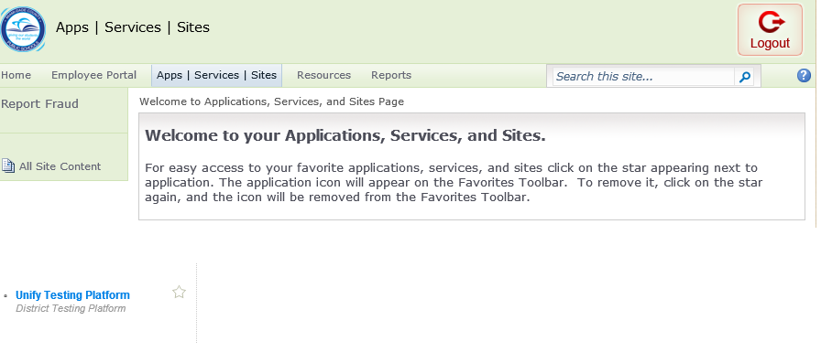
MDCPS Login

Slide 6
Agenda
MyUnify

Slide 7
Teacher View: MyUnify - Home Page

Slide 8
Unify - Home Page

Slide 9
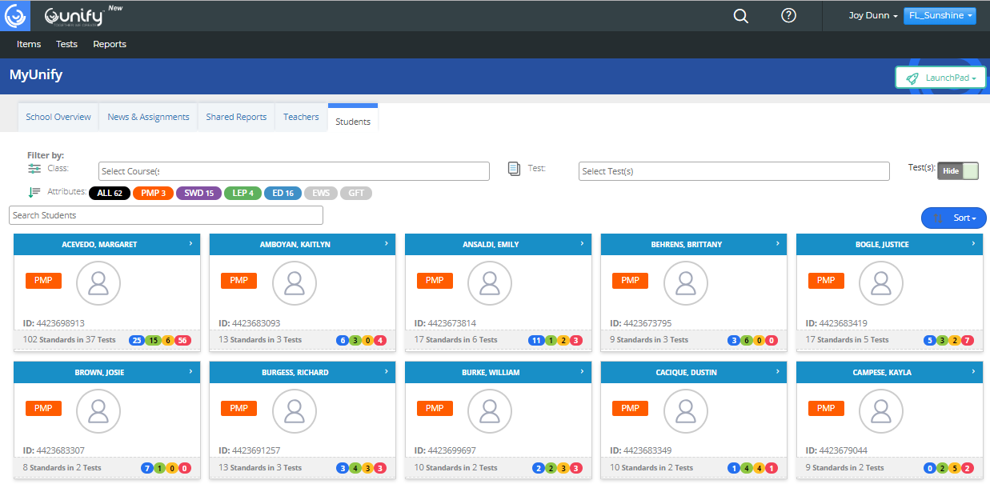

Slide 10
Unify - Home Page

Slide 11
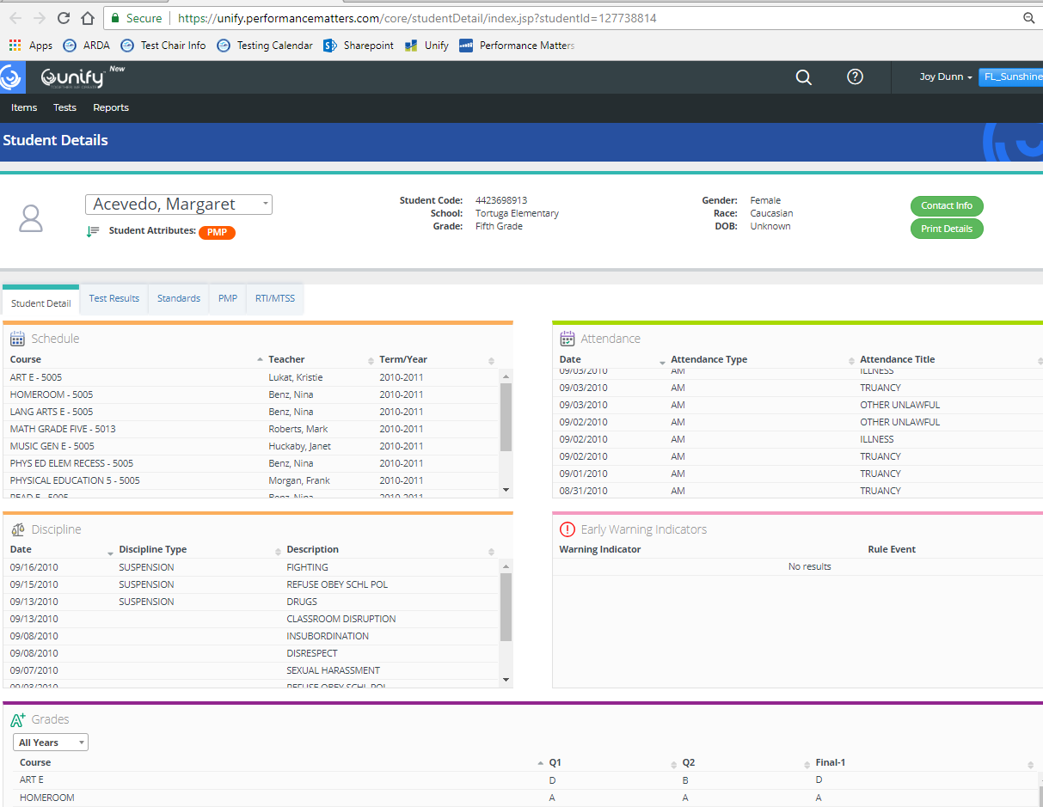
Student Detail

Slide 12
Student Detail

Slide 13
Agenda
MyUnify
Test Center

Slide 14
Test Center

Slide 15
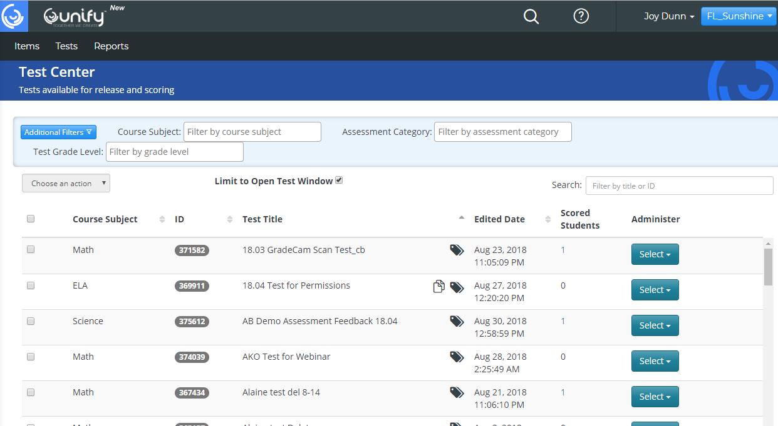

Slide 16
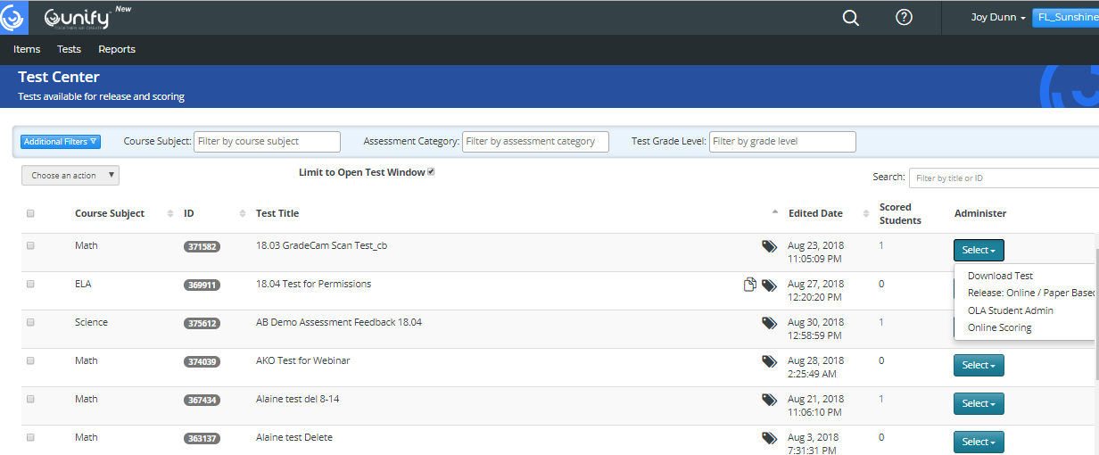
OLA

Slide 17
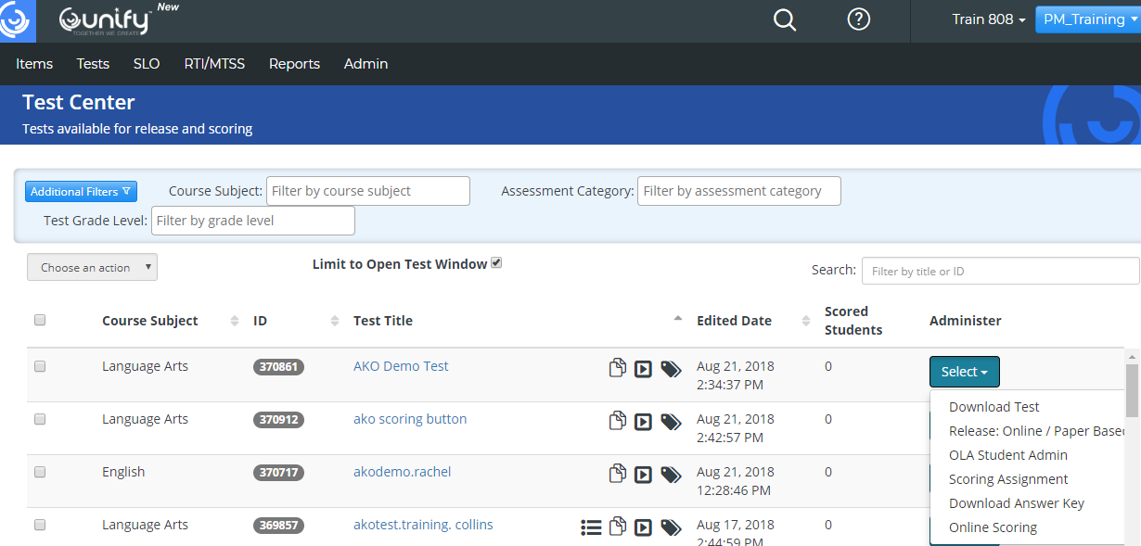
Print
Scan Sheets
Click on the Select button
Scroll down to the Release:Online /Paper Based

Slide 18
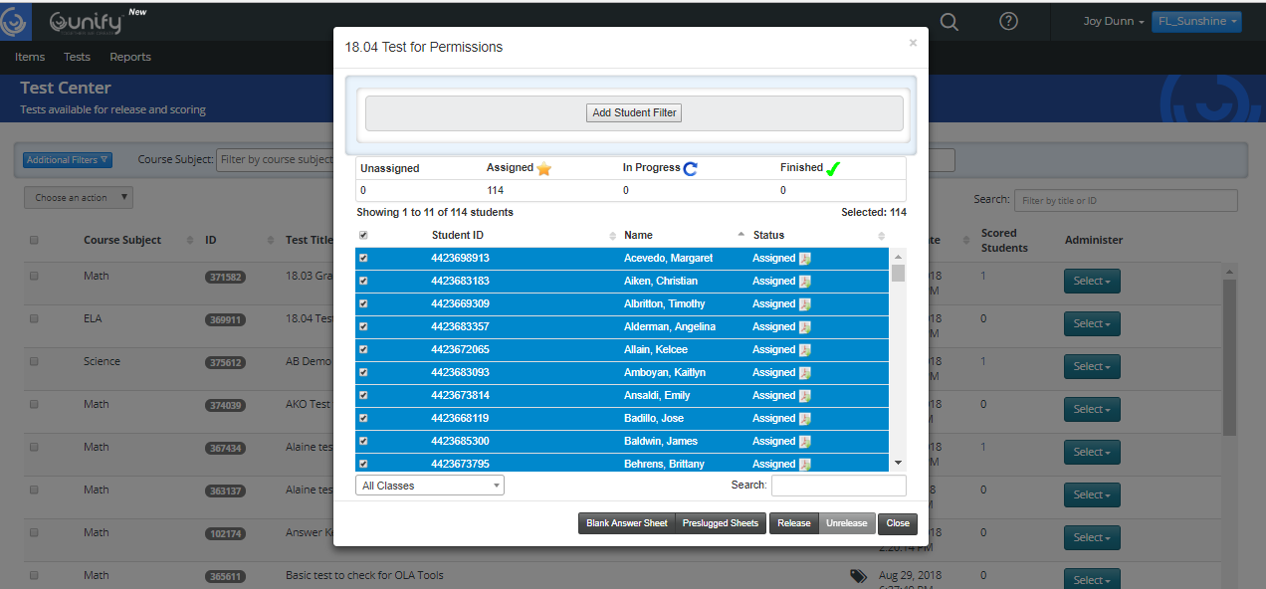
Print
Bubble Sheets
Click on the Preslugged Sheets

Slide 19
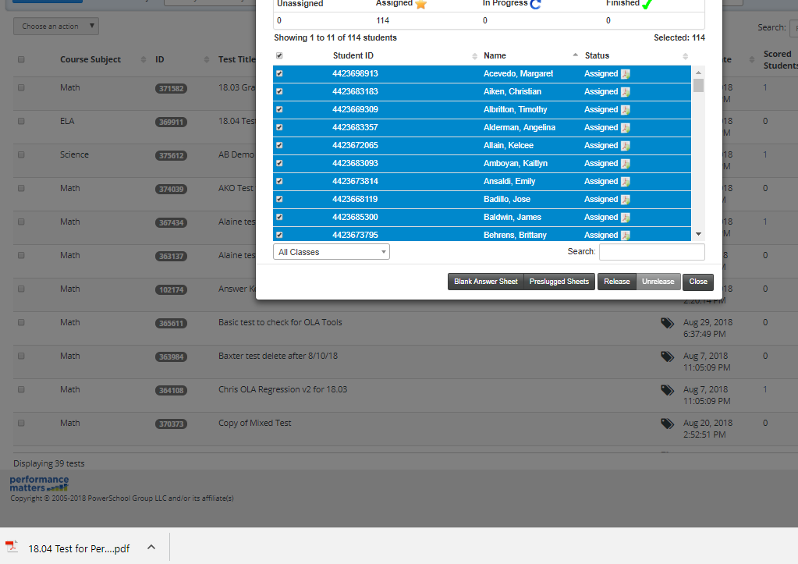
Print
Scan Sheets
PDF of Preslugged Sheets will download to computer.

Slide 20
Agenda
MyUnify
Test Center
Scanning

Slide 21
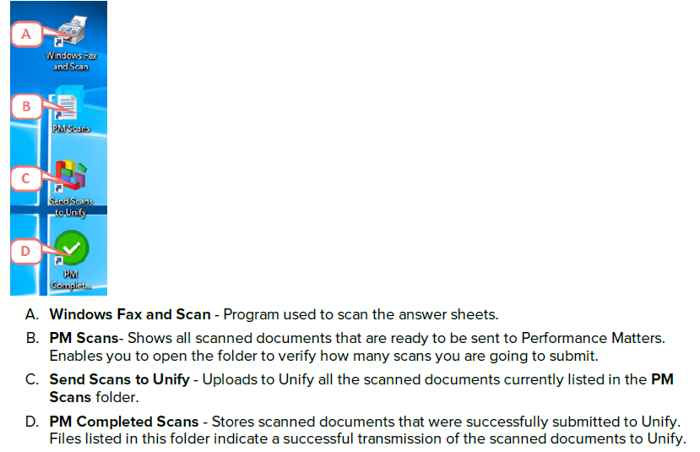
Scanning Bubble Sheets

Slide 22
Click the Windows Fax and Scan icon

Slide 24
The Scan image will appear at the bottom

Slide 25
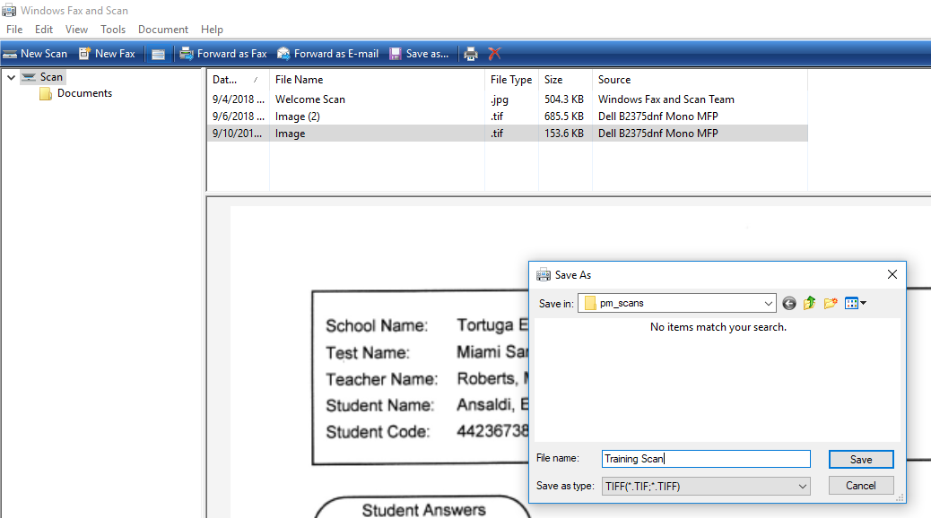
Right click Save As:
Save in pm_scans
1. Name the file
2. Click Save
3. Close Windows Fax and Scan

Slide 26
Click PM Scans

Slide 27
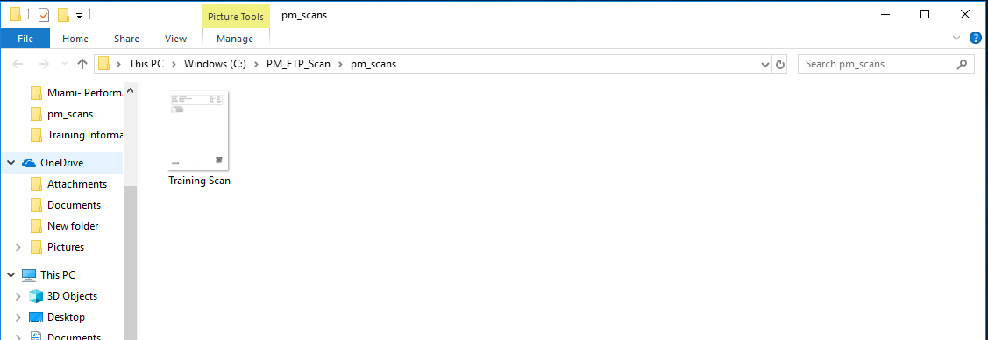
Saved scan will appear
Leave this window open

Slide 28
Click on Send Scans to Unify

Slide 29
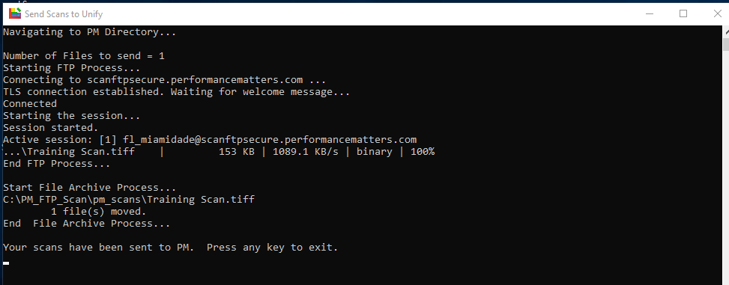

Slide 30
Click PM Complete

Slide 31
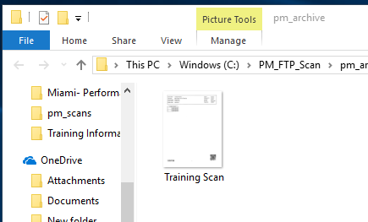
1. Scan will appear
2. Exit out of this window
3. Go back to Unify

Slide 32
Scanview
Click on the Blue icon in the left-hand corner.
Select Scanview from the dropdown menu.
QuickDoc

Slide 33
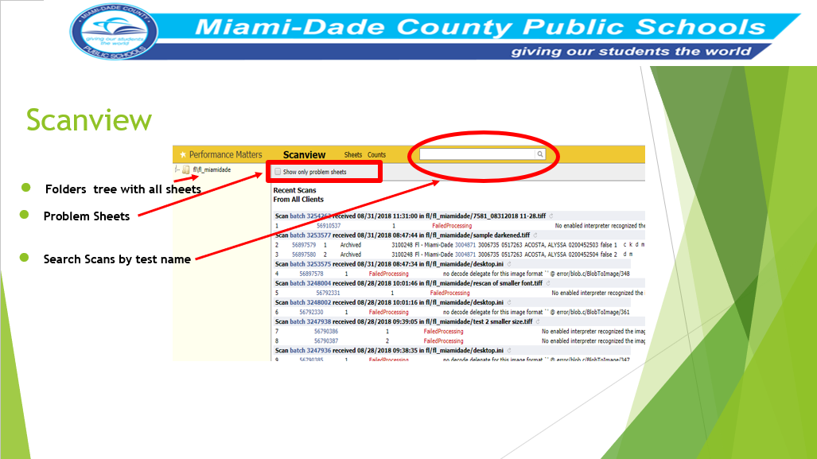

Slide 34
Agenda
MyUnify
Test Center
Scanning
OLA Student Administration

Slide 35
Click on the Unify icon in the left-hand corner.
Select Tests from the dropdown menu.
Choose OLA Student Admin.
OLA Administration

Slide 36
OLA Student Administration
Search for test using filters
Search for test from drop box

Slide 37
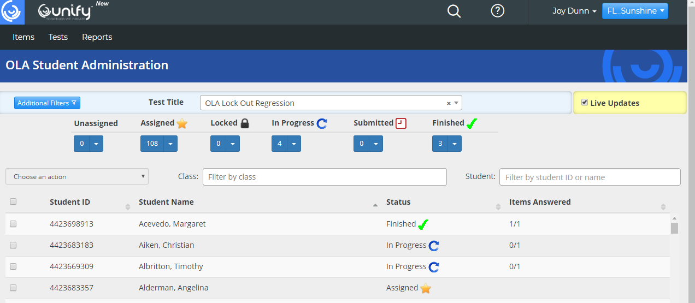
OLA Student Administration
Live Updates checks the status of the test.

Slide 38
OLA Student Administration
6 Statuses
Unassigned
Assigned
Locked
In Progress
Submitted
Finished

Slide 39
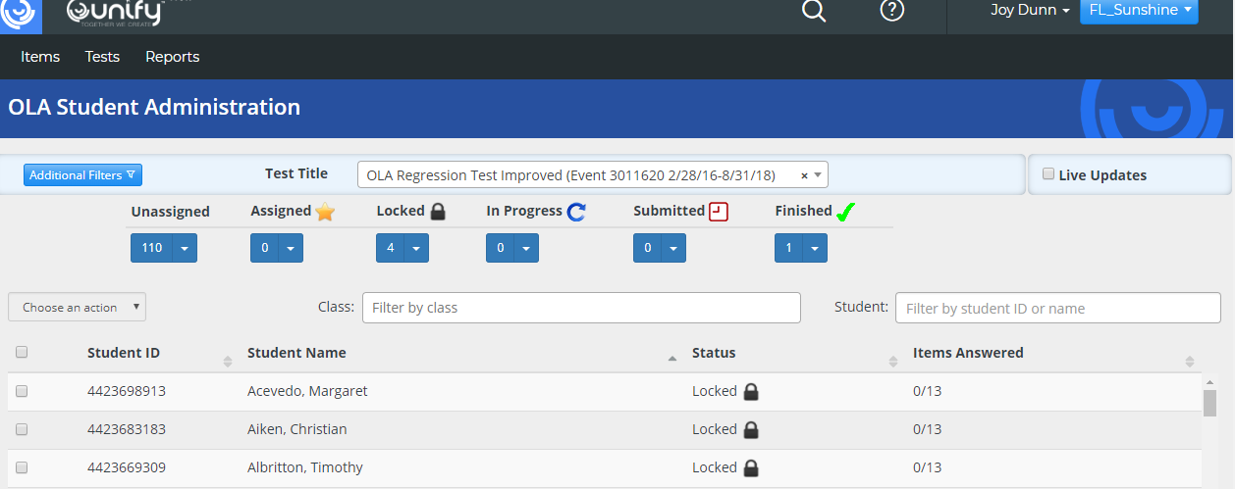
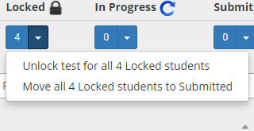
OLA Student Administration
Manage Secure Test lockout feature
Dropbox

Slide 40
Agenda
MyUnify
Test Center
Scanning
OLA Student Administration
Student Item Analysis

Slide 41
Student Item Analysis
Select Reports
Select Student Item Analysis from the dropdown menu
Quick doc reference sheet link

Slide 42
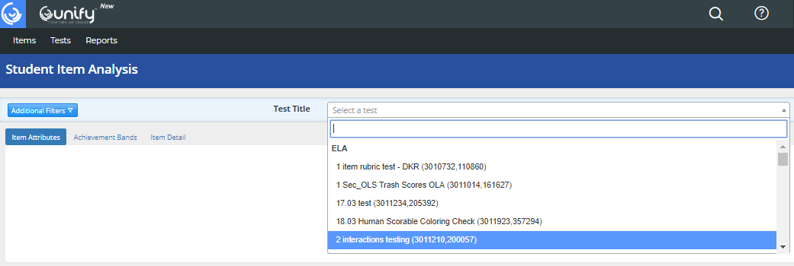

Slide 44
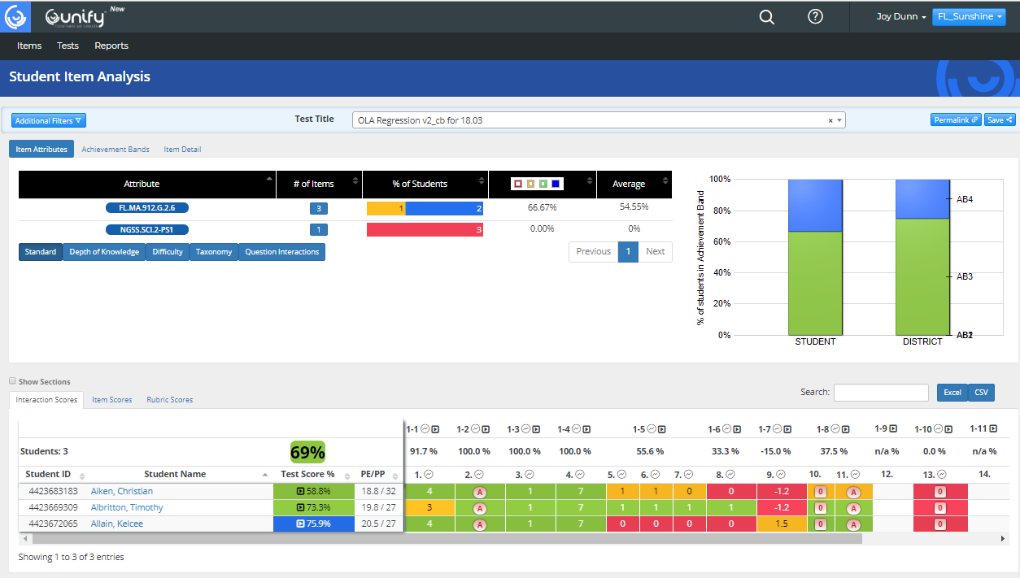
Student Item Analysis

Slide 45
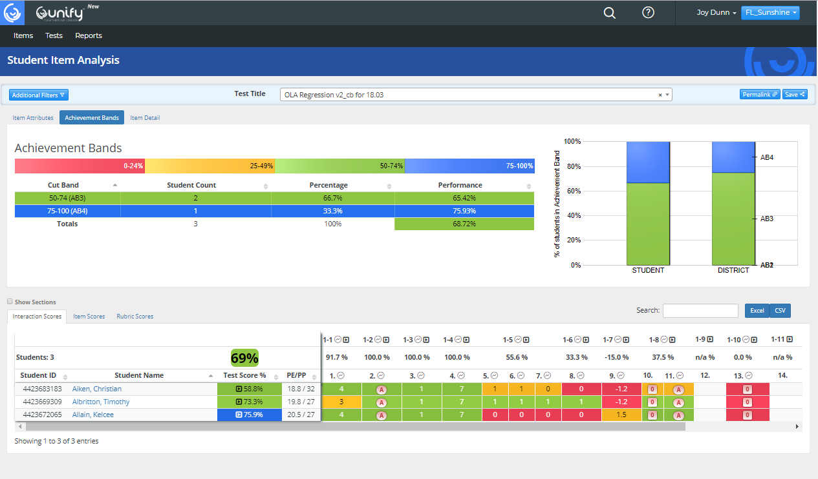
Student Item Analysis

Slide 46
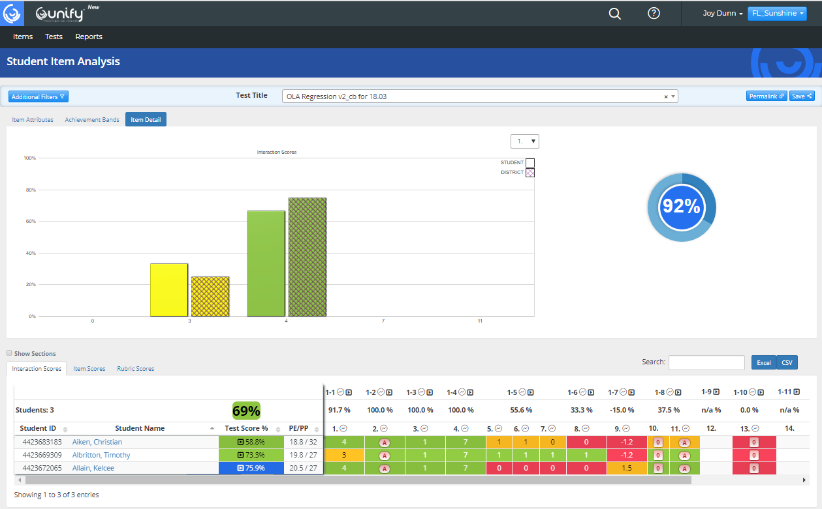

Slide 47
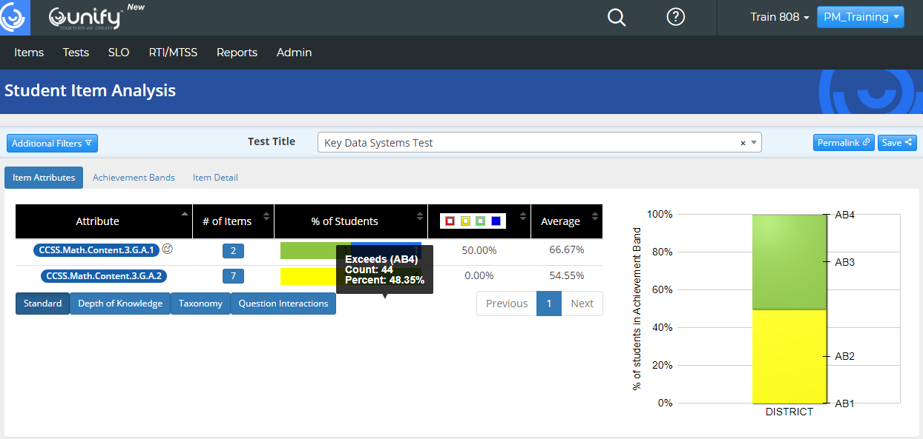

Slide 48
Student Item Analysis

Slide 50
Program Contacts
Ms. Felicia Mallory, Executive Director
FMallory@dadeschools.net Phone: 305-995-1213
Ms. Denetra Collins, Staff Specialist Collinsd@dadeschools.net Phone: 305-995-4580
Performance Matters Test Platform Support Team
Marva Wilks, Ed.S. Program Manager
Marlene Lorie, MS. Education Consultant
Rosemary Stephens, Ed.S. Education Consultant
Email: Testplatform@dadeschools.net
Phone: 305-995-2345

